Slide 1
Vic Ulfik – G4YIP

Slide 2
What is it – Background
Footprint & Bandplan
My TX/RX setup
Antennas
Finding the Satellite
What you need to get on Q0100
Questions

Slide 3
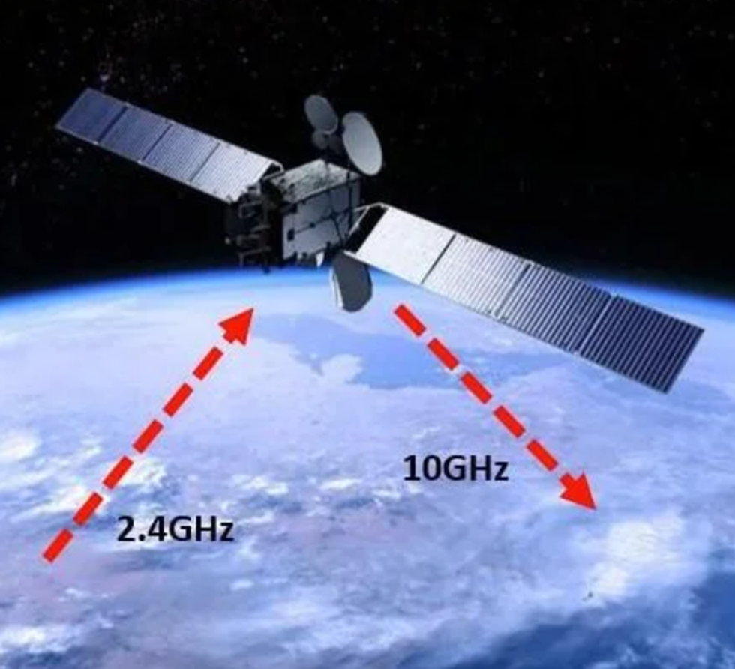
Geostationary satellite Es’hail-2 - Background
Launched from Kennedy Space Centre in 2018
Geostationary orbit at 25.9° East.
The first amateur radio transponders to be put into geostationary orbit and they are expected to link radio amateurs from Brazil to Thailand.
Es’hail-2 carries two “Phase 4” amateur radio transponders operating in the 2400 MHz and 10450 MHz bands.
A 250 kHz bandwidth linear transponder intended for conventional analogue operations and an 8 MHz bandwidth transponder for experimental digital modulation schemes and DVB amateur television.
Narrowband Linear transponder
2400.050 - 2400.300 MHz Uplink
10489.550 - 10489.800 MHz Downlink
Wideband digital transponder
2401.500 - 2409.500 MHz Uplink
10491.000 - 10499.000 MHz Downlink

Slide 4
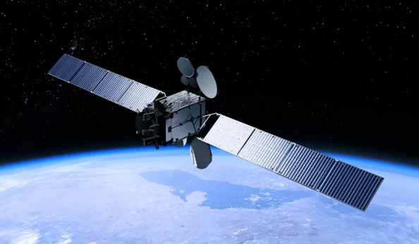
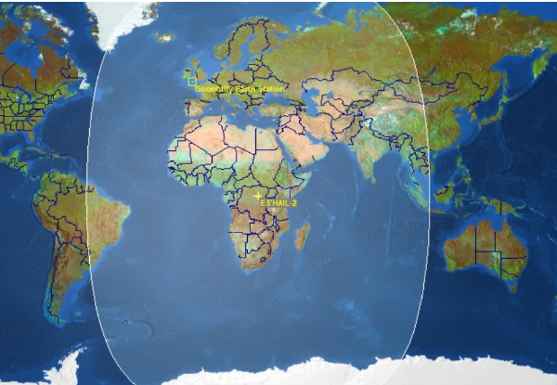
Geostationary satellite Es’hail-2 – Footprint

Slide 5
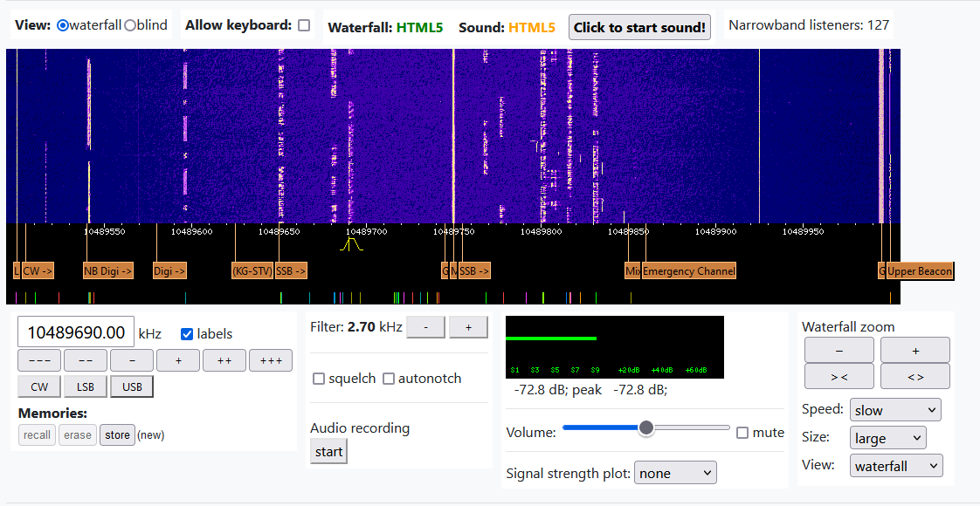
Geostationary satellite Es’hail-2 – Band plan

Slide 6
Geostationary satellite Es’hail-2 – Listening in
https://eshail.batc.org.uk/

Slide 7
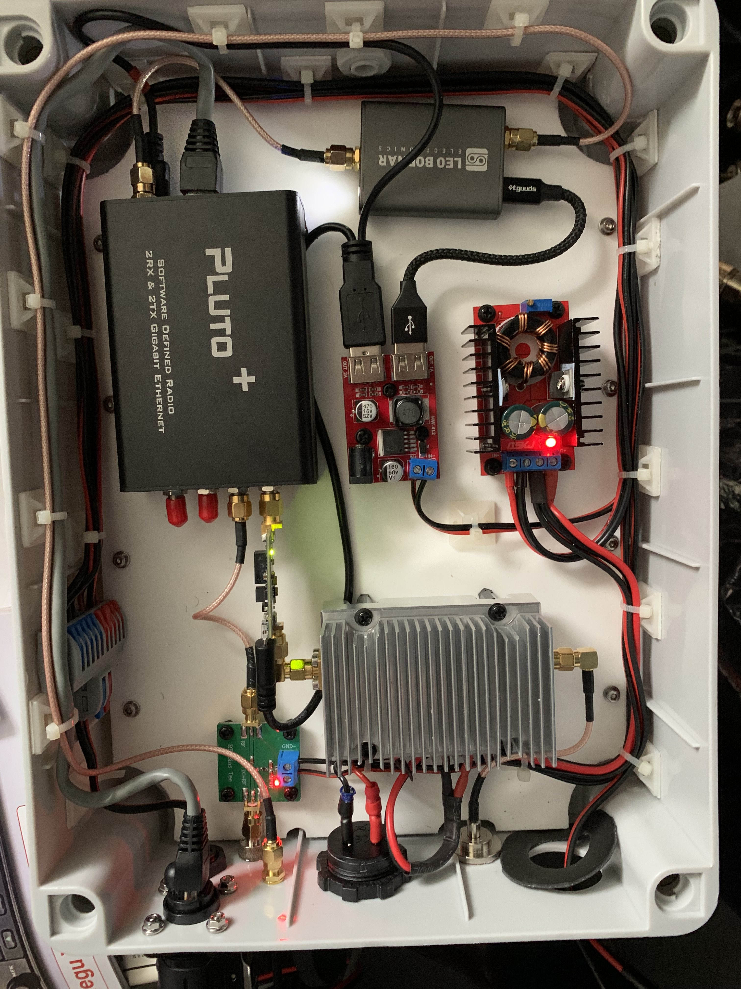
Geostationary satellite Es’hail-2 – What’s in the box?
12v – 28v step up transformer
Twin USB
Leo Bodner GPS 40MHz fixed clock signal
2.4GHz PA – 0.40 to 20watts
TX out
Pre amp .04 - .40 watt
Bias T
SDR Transceiver 70MHz-6GHz Software Defined Radio
GPS In
TX
LNB In – 790MHz
RX
12 volt input
CAT 45 in/out
CAT 45 Cable link
12 volt distribution

Slide 8
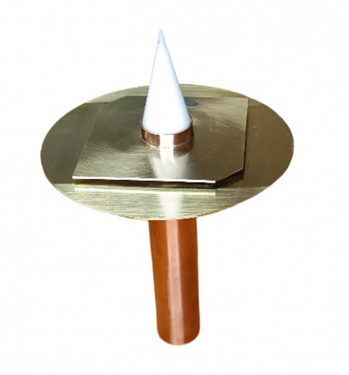
Geostationary satellite Es’hail-2 – POTY Antenna
(Patch Of The Year)

Slide 9
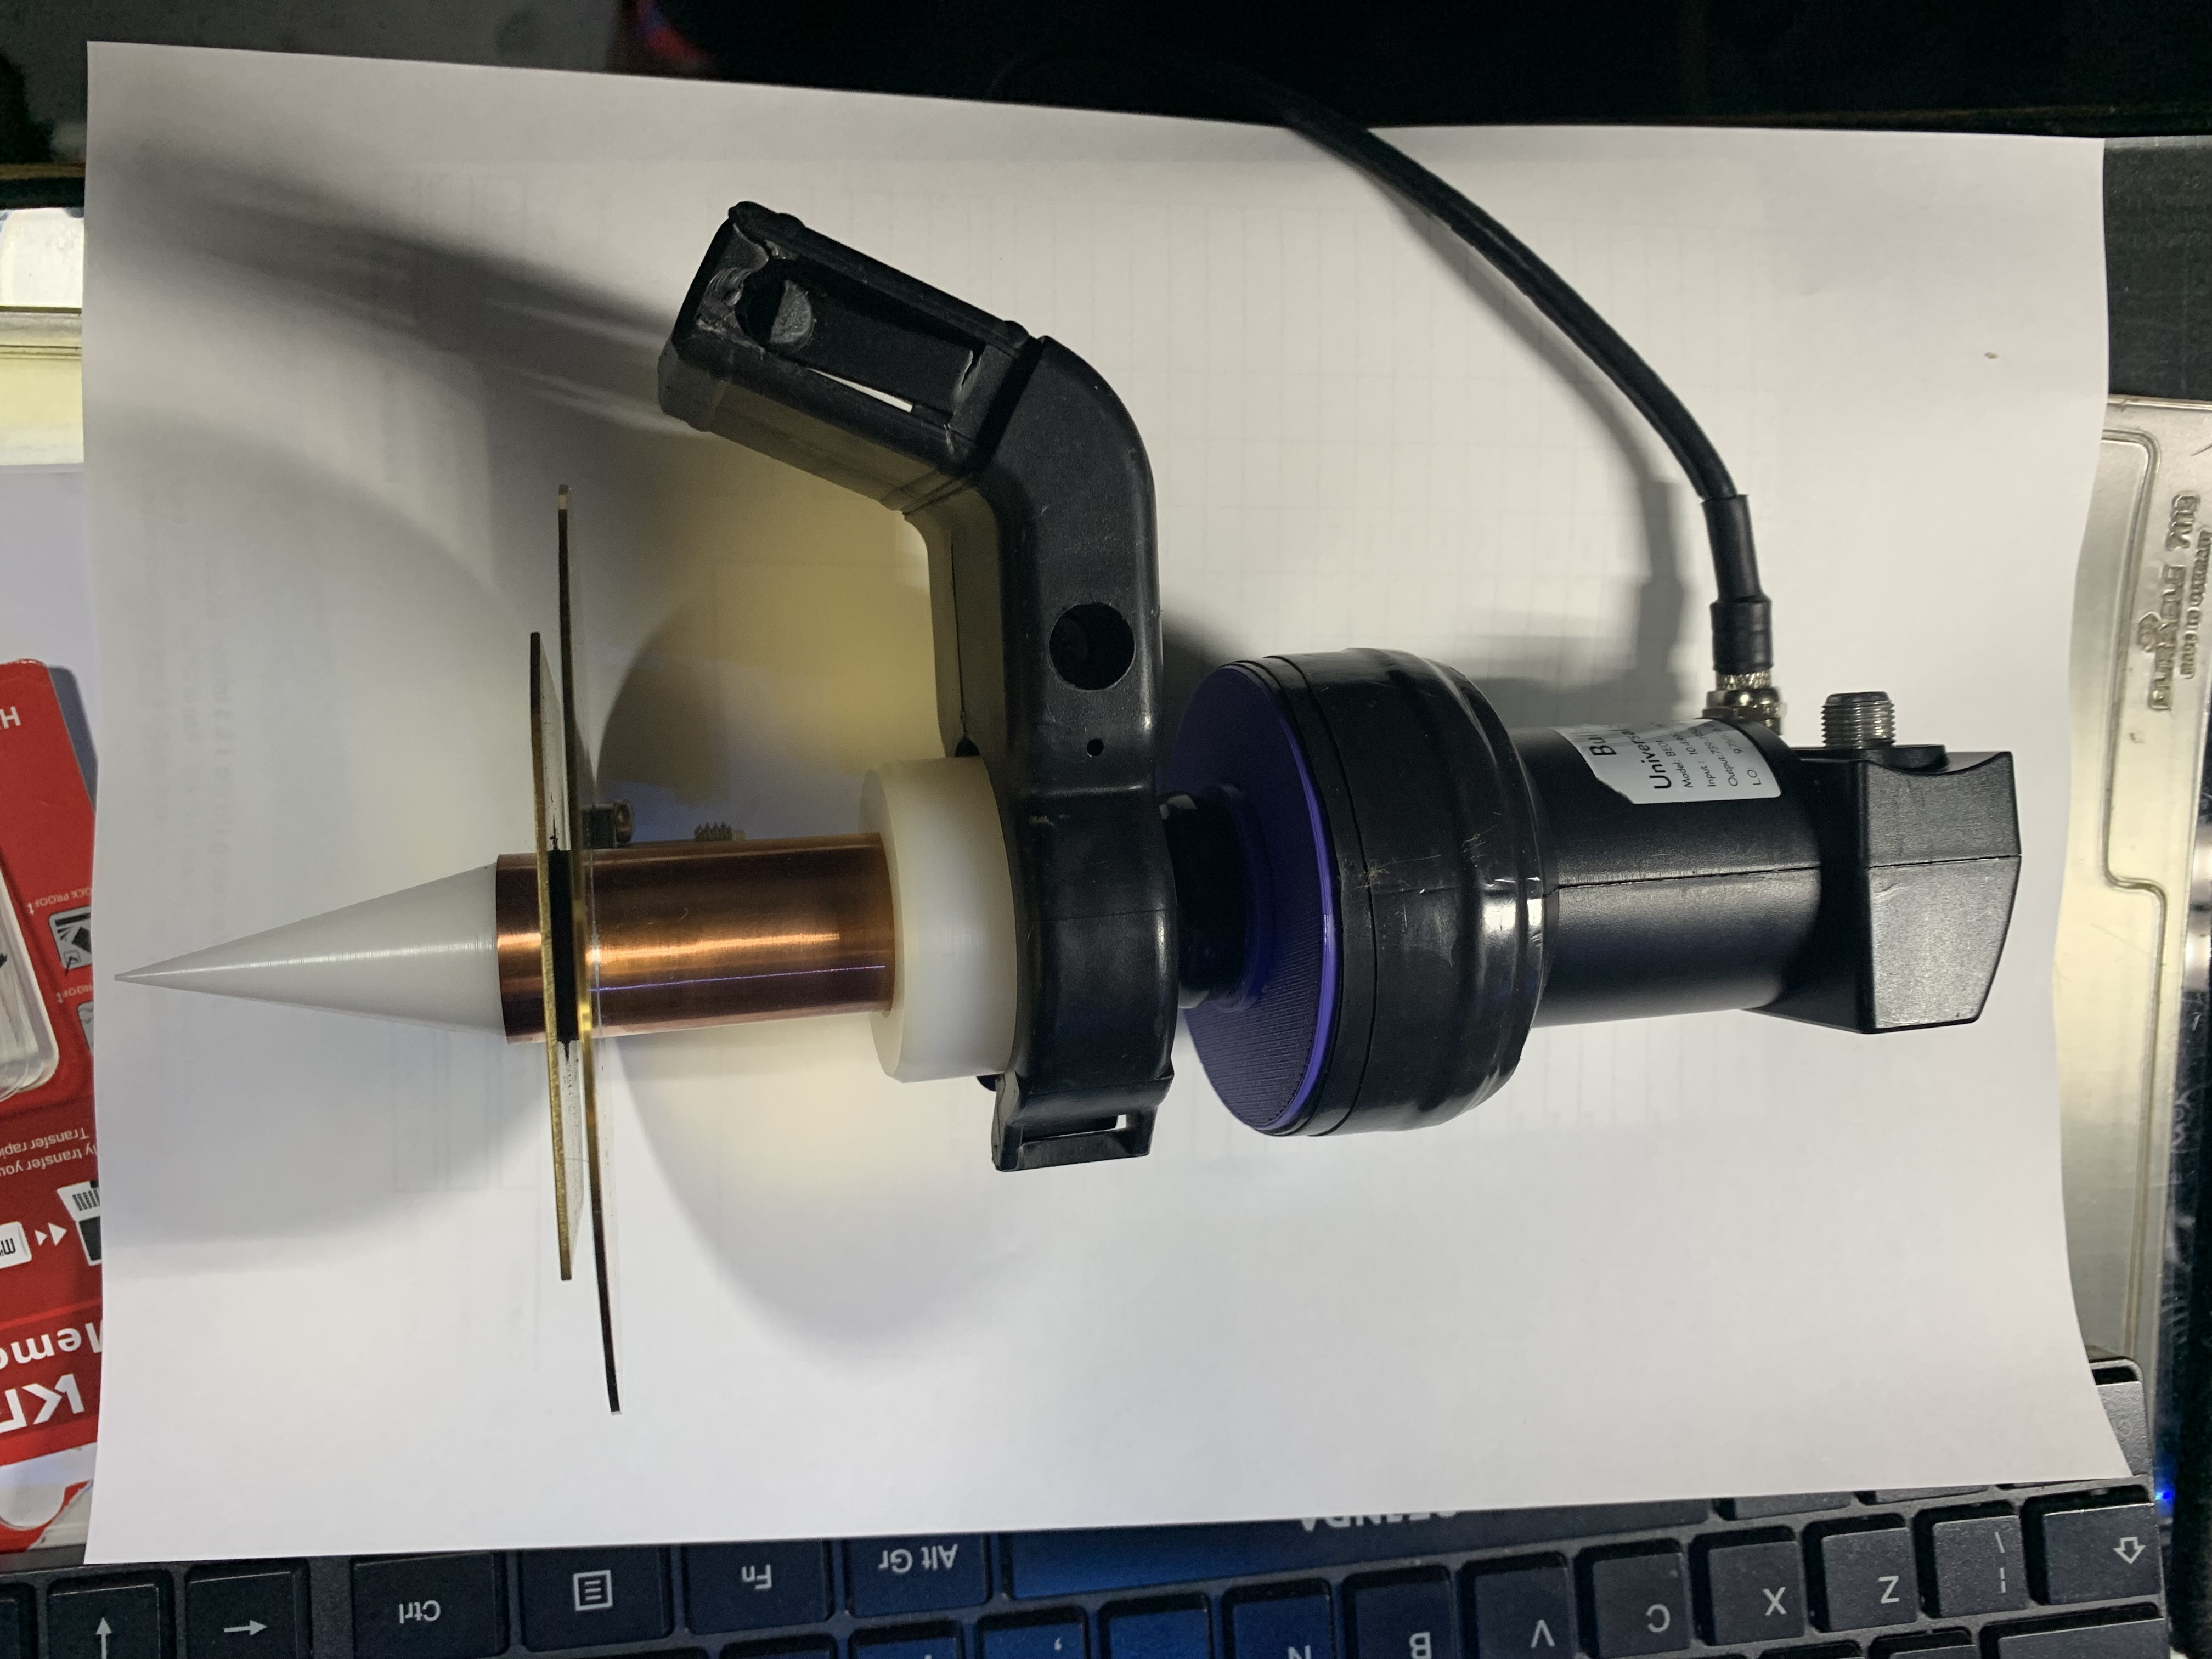
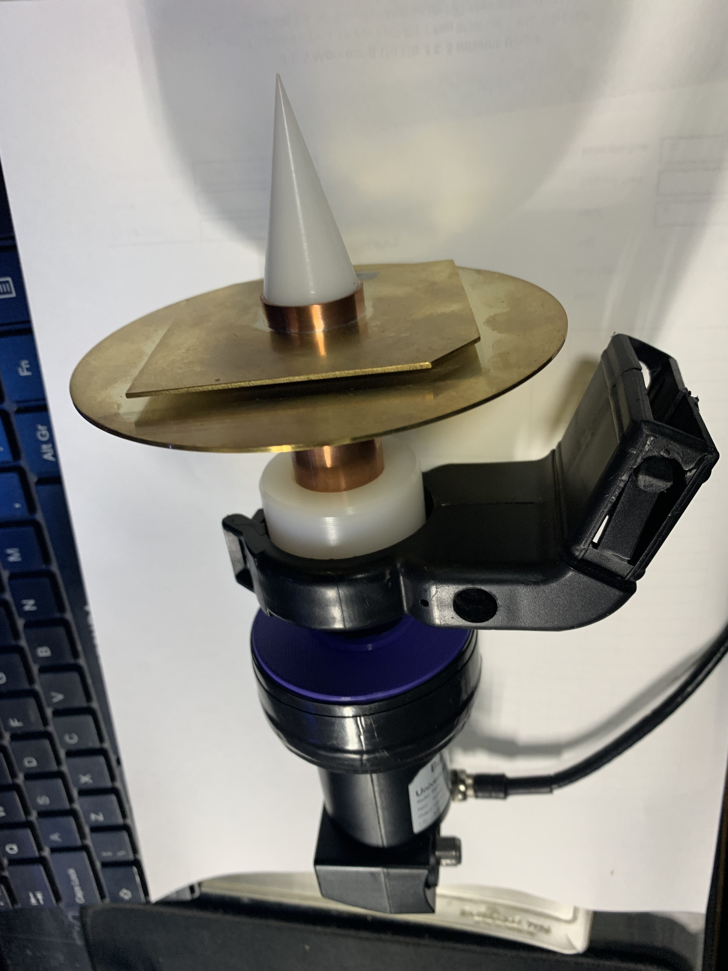
Geostationary satellite Es’hail-2 – POTY Antenna
(Patch Of The Year)

Slide 10
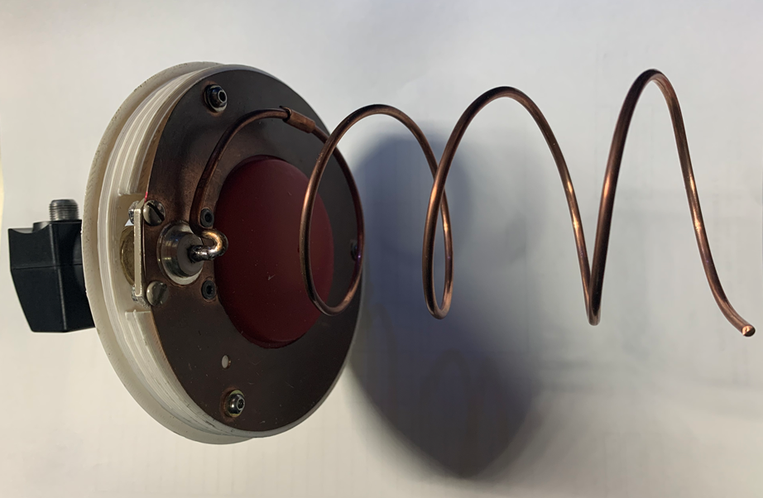
Geostationary satellite Es’hail-2 – Helix Antenna
RX

Slide 11
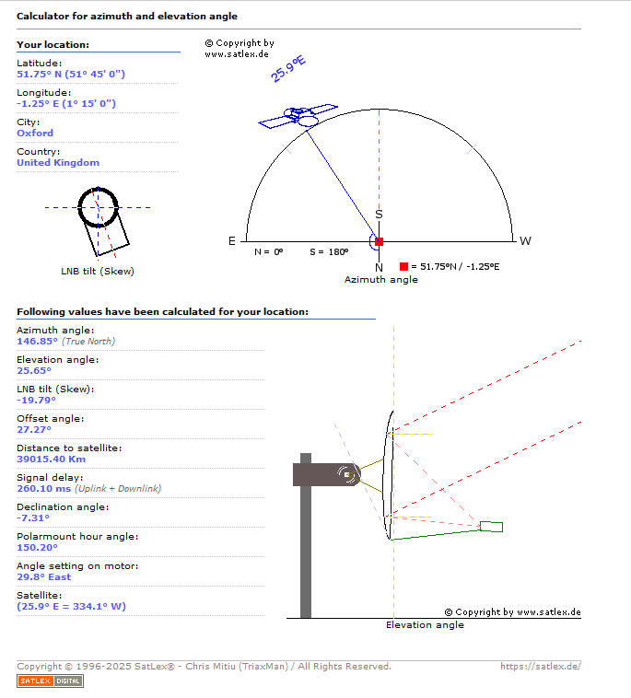
Geostationary satellite Es’hail-2 – Finding QO 100

Slide 12
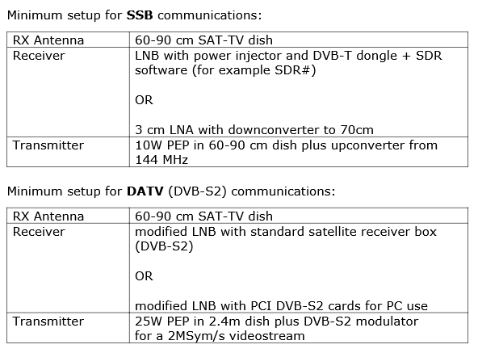
Geostationary satellite Es’hail-2 – Hardware required

Slide 13
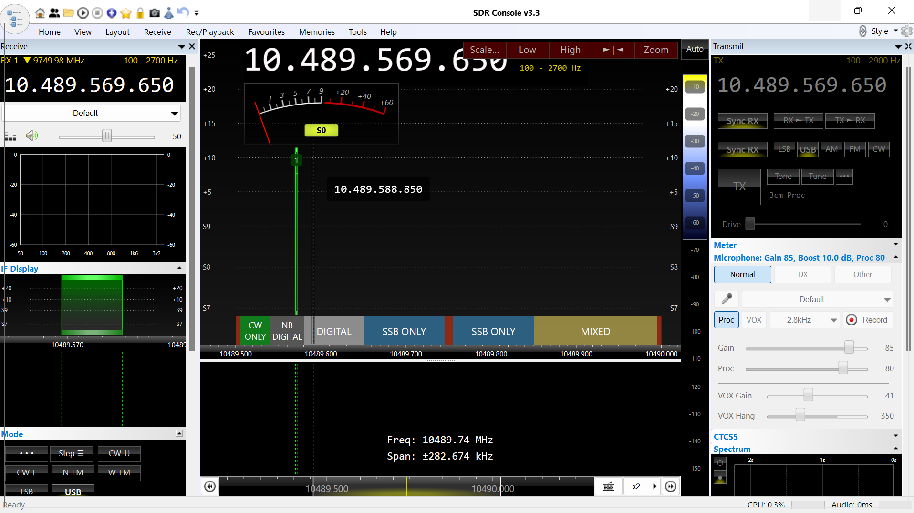
Geostationary satellite Es’hail-2 – Software required

Slide 14
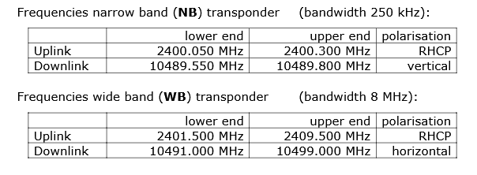
Geostationary satellite Es’hail-2 – Operating frequencies

Slide 15
Listen to Es’hail-2 online with the AMSAT-UK / BATC WebSDR located at Goonhilly https://eshail.batc.org.uk/ Find the satellitehttps://satlex.de Me Chris M7SYT
Geostationary satellite Es’hail-2 – More information

Slide 16
Questions
Geostationary satellite Es’hail-2 – More information

Slide 17
