Slide 1
The contest year - 2024

Slide 2
A review of which contests the club and individual club members supported in 2024

Slide 3
A review of which contests the club and individual club members supported in 2024
Who took part in what

Slide 4
A review of which contests the club and individual club members supported in 2024
Who took part in what
Results achieved

Slide 5
A review of which contests the club and individual club members supported in 2024
Who took part in what
Results achieved
Background info on contests – rules, scoring and how to take part

Slide 6
What did we do in 2024?
Supported Chesham & DARS in the UKACs, AFS Super League and the VHF Championship
As a club or individually we participated in the:
    VHF/UHF FT8 contests
    80m Club Championship
    80m Autumn Series
    VHF/UHF Christmas Cumulatives
    Practical Wireless 144MHz and 70MHz

Slide 7
What are the UK Activity Contests?
A series of short contests to:
Promote activity on the VHF/UHF/SHF bands
Encourage innovation and construction
Improve operating skill
Understand propagation
Have fun!

Slide 8
AFS Super League
Eight weekend contests throughout the year
Four on VHF/UHF – 50, 70, 144 and 432MHz
Four on HF - 160m and 80m (CW/SSB/Data – PSK63/RTTY)
Chesham & DARS 3rd out of 61in the 2023/24 series with NRC support
For 2024/25 currently 3rd with one event to go

Slide 9
VHF Championship
11 weekend contests through the year
50MHz to 10GHz
Most co-ordinated with Eu events
Best 7 scores count
Club and individual awards
Scores automatically counted
Chesham & DARS wins in 2024 with NRC support

Slide 10
If digital is your scene...
The FT8 Activity contests are on 144MHz and 432MHz
Two or four hours on Wednesday evenings (1st and 2nd) starting at 17.00 or 19.00 UTC
Exchange is report as appropriate for FT8 and four digit IARU locator (eg IO92)
Scored at one point per kilometre plus squares bonus
Aligned with FT8 contests in Europe

Slide 11
VHF/UHF FT8 results
On 144 MHz Jason G7LII wins both the 2 hour and 4 hour sessions in the low power (10W) category
On 432 MHz Jason G7LII wins both the 2 hour and 4 hour sessions in the low power (10W) category

Slide 12
80m Club Championship
Take place each month February to July
One session each of CW, Data (PSK63 and RTTY) and SSB every month
90 minute sessions on Monday, Wednesday and Thursday evenings starting at 20.00z
Club score is normalised to leader's score
Sections for 100W or 10W, assisted or unassisted

Slide 13
80m Autumn Series
Take place each month from September to November
Same format as Club Championship but Foundation and Intermediate Licensees score more for their club
On CW, there are two slow speed (15 wpm maximum) sections

Slide 14
Christmas Cumulatives
Runs in the days between Christmas and New Year
Four bands 50/70/144/432MHz on different days
Fairly well supported in the UK and EI/Europe
Not a club series

Slide 15
Christmas Cumulatives
Runs in the days between Christmas and New Year
Four bands 50/70/144/432MHz on different days
Fairly well supported in the UK and EI/Europe
Not a club series
Jason G7LII was the overall runner-up last year

Slide 16
Practical Wireless contests
144MHz contest takes place in June
70MHz contest takes place in September
Multi or single operator
12th place on 144MHz
5th place and leading station in IO92 on 70MHz

Slide 17
UKACs - what and when
All evening events
SSB/CW – Tuesdays and Thursdays
FM – Tuesdays before the SSB/CW sessions

Slide 18
Who can take part?
Anyone can take part
Any RSGB member or member of an RSGB Affiliated Society can enter
As this club is affiliated to the RSGB all club members are eligible

Slide 19
SSB/CW schedule
1st Tuesday – 144MHz
2nd Tuesday – 432MHz
2nd Thursday – 50MHz
3rd Tuesday – 1296MHz
3rd Thursday – 70MHz
4th Tuesday – SHF (2.3/3.4/5.7/10GHz)
Start time is 20.00z, finish 22.30z (SHF starts at 19.30z)

Slide 20
Equipment and power
A multi-mode VHF/UHF transceiver
An antenna, preferably horizontally polarised
Log sheets and a clock
A computer
Your licence determines the maximum power you can use
However, you may choose to run less than the maximum permitted as there are three sections to choose from

Slide 21
What are the sections?
Open (AO) allows maximum licensed output power and multiple antennas
Restricted (AR) allows a maximum of 100W PEP and a single antenna
Low power (AL) allows a maximum of 10W PEP and a single antenna
Power limits on 70MHz are different: 160W, 50W and 10W

Slide 22
How do I start?
Choose which event to enter
Choose the section – AO, AR or AL
Decide whether to log on paper or use logging software
Read the rules, decide on your tactics
Make as many points as possible
Enter your log

Slide 23
How are they scored?
Points per kilometre
500 points bonus for the first contact with each IARU locator square (IO92/93/81 etc.)
Final points awarded to your club are determined by your position in the results table

Slide 24
What is an IARU locator?
Pinpoints your location to a few km anywhere in the world
Based on latitude and longitude
Each large square is 20 degrees wide by 10 degrees high
Large squares are sub-divided into 100 smaller squares numbered 00 to 99
These smaller squares are further sub-divided into 576 squares designated AA to XX

Slide 25
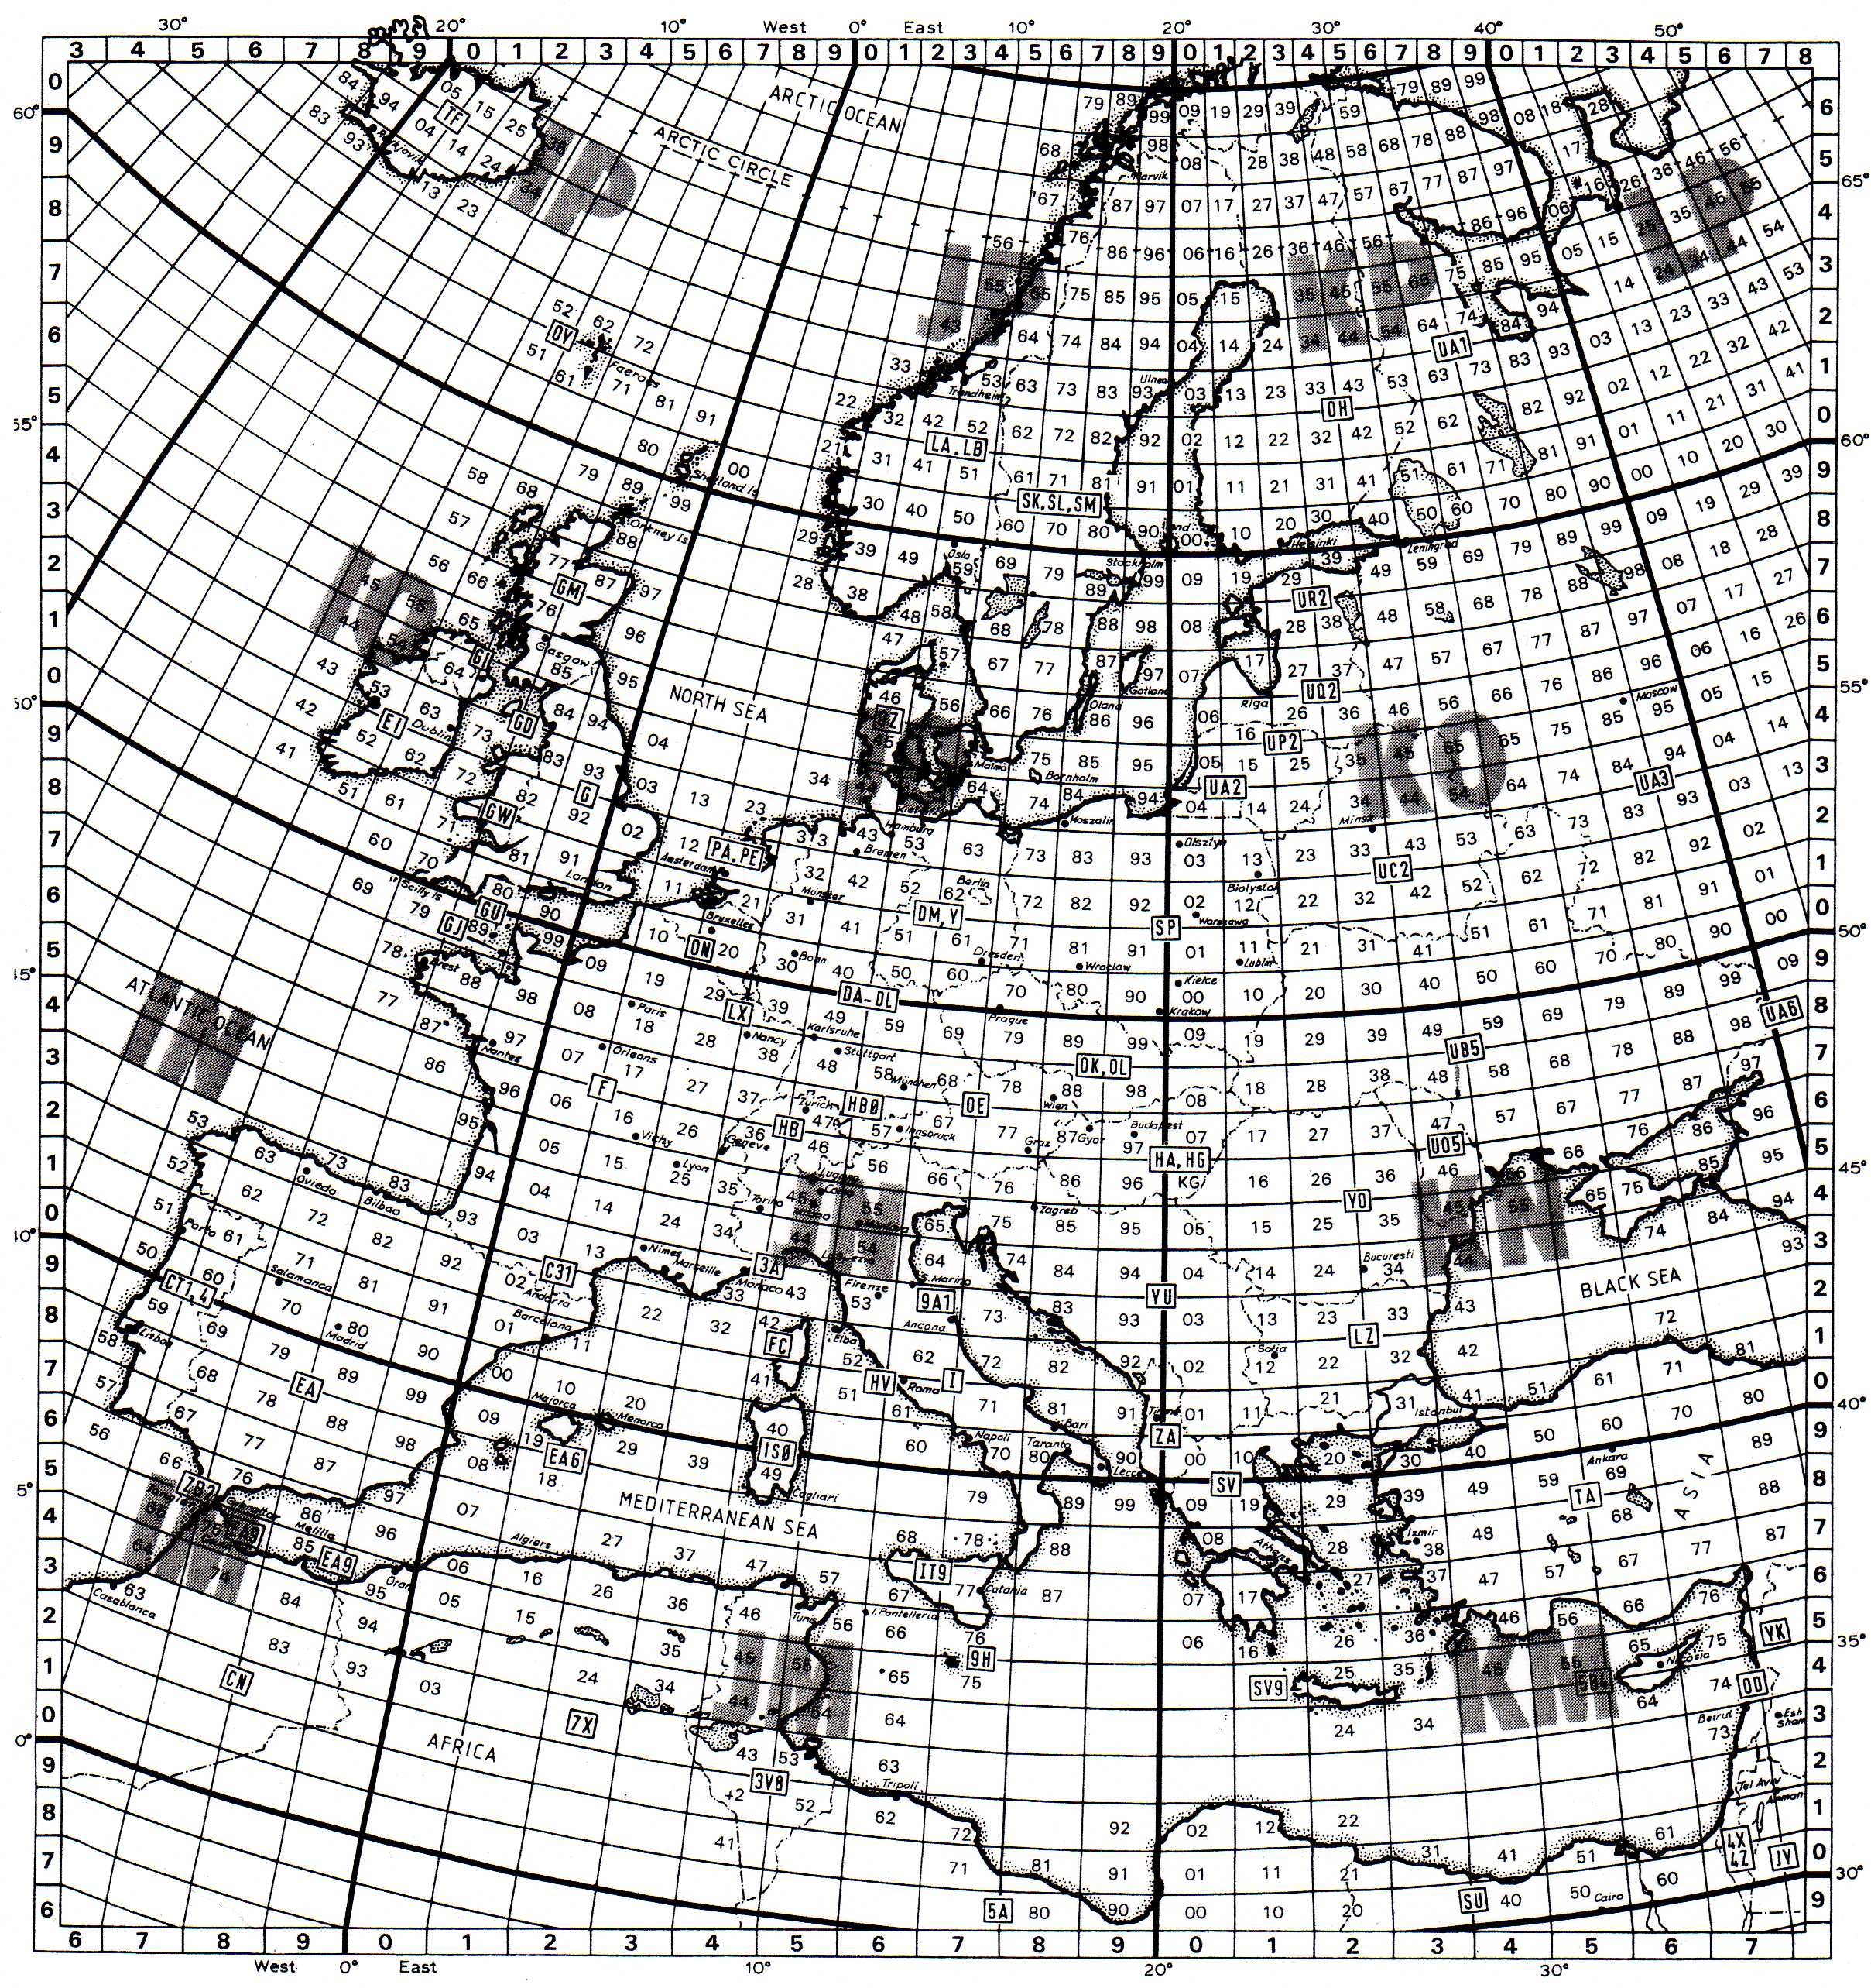
Locator map

Slide 26
What is the contest exchange?
Signal report, RS or RST
Serial number starting at 001
Your IARU locator
Typical report would be:
  59 001 IO92NF
Keep to this order
Accuracy is paramount! You will lose all the contact points for any errors. Ask for a repeat if not sure you have received it correctly.

Slide 27
Useful software
Minos written by Mike G0GJV et al
N1MM+ and SD by EI5DI
Hepburn tropo predictions
ON4KST chatroom
AirScout by DL2ALF for aircraft scatter prediction

Slide 28
How do I enter my log?
Go to the RSGBCC website
Choose the contest from the home page
Find the 'upload' button and upload your log
If you have a paper log, choose the online log generator system
Logs must be entered within 7 days

Slide 29
When do I see the results?
Results usually come out about a week or two after the closing date for entries
See https://www.rsgbcc.org
You can set up an email alert for the results

Slide 30
How did we do in 2024?
Overall 2nd out of 49 in the Local Club Category
2023 - 3rd out of 44
3rd out of 31 on 50MHz (2023 - 3rd)
3rd out of 34 on 70MHz (2023 - 3rd)
3rd out of 43 on 144MHz (2023 - 3rd)
2nd out of 38 on 432MHz (2023 - 3rd)
2nd out of 30 on 1296MHz (2023 - 4th)
8th out of 11 on SHF (2022 – 10th)

Slide 31
Participants 2024
David 2E0OUR Vic G6GDI
John G0ODQ Richard G6TVB
Dick G0MHZ Jason G7LII
Matt G0XDI Dave G8FMC
Dave G1MZD Bob G8MFH
Roger G3MEH Trevor M0IIB
Malcolm G3ZNU Phil M0NVS
John G4CZB Anthony M0UBT
Steve G5IIA Roger M7RMF
Dave G4RGK Andrew M7RWK

Slide 32
What is a 'Local Club'?
Home stations of all entrants are located within 80km of the club's meeting place
Clubs can designate a 'virtual meeting place' which helps if a club is near the sea or in a very rural area
A 'General Club' covers groups with National coverage like RSARS, contest groups and clubs that have members no longer living locally
Location is determined by home station address

Slide 33
If you only have FM....
The FM Activity contests take place on 2m and 70cm in the hour before the UKACs
Two sections for 10W or 50W out
No antenna restrictions
Same format, exchange signal report, serial number and locator
See the rules for frequency limits which avoid the popular channels for local communication
Some long distance contacts can be made as there will be many stations on remote hilltops

Slide 34
A successful year?
2nd place in the UKACs
3rd place in the AFS Super League
Won the VHF Championship
15th out of 49 in the 80m Club Championship
9th out of 33 in the 80m Autumn Series
12th/5th place in the PW 144/70MHz contests

Slide 35
Club callsigns
G3GWB and G8LED
Our SCC (short contest callsign) is G8N

Slide 36
Summing up
Remember – in club events all contacts add to the overall score

Slide 37
Summing up
Remember – in club events all contacts add to the overall score
Club points are calculated from your position in the results table

Slide 38
Summing up
Remember – in club events all contacts add to the overall score
Club points are calculated from your position in the results table
You can make a useful contribution even with a simple antenna

Slide 39
Summing up
Remember – in club events all contacts add to the overall score
Club points are calculated from your position in the results table
You can make a useful contribution even with a simple antenna
The successful clubs are those that get the most stations on the air in as many sessions as possible

Slide 40
Where to find contest info
RSGBCC website – www.rsgbcc.org
Bruce Horn WA7BNM: www.contestcalendar.com

Slide 41
NRC plans for 2025
A change to the informal arrangement between Northampton RC and Chesham & DARS where this year CDARS will support NRC in the UKACs
NRC will continue to support CDARS in the AFS Super League and the VHF Championship
NRC will enter the 80m Club Championship
Autumn Series on 80m left open for agreement

Slide 42
Any questions?

